Slide 1

Instrumentation System for
Liquid
Drop Impact
& Evaporation
Daniel Eisen
Supervisor: Dr. Gideon Gouws

Slide 2
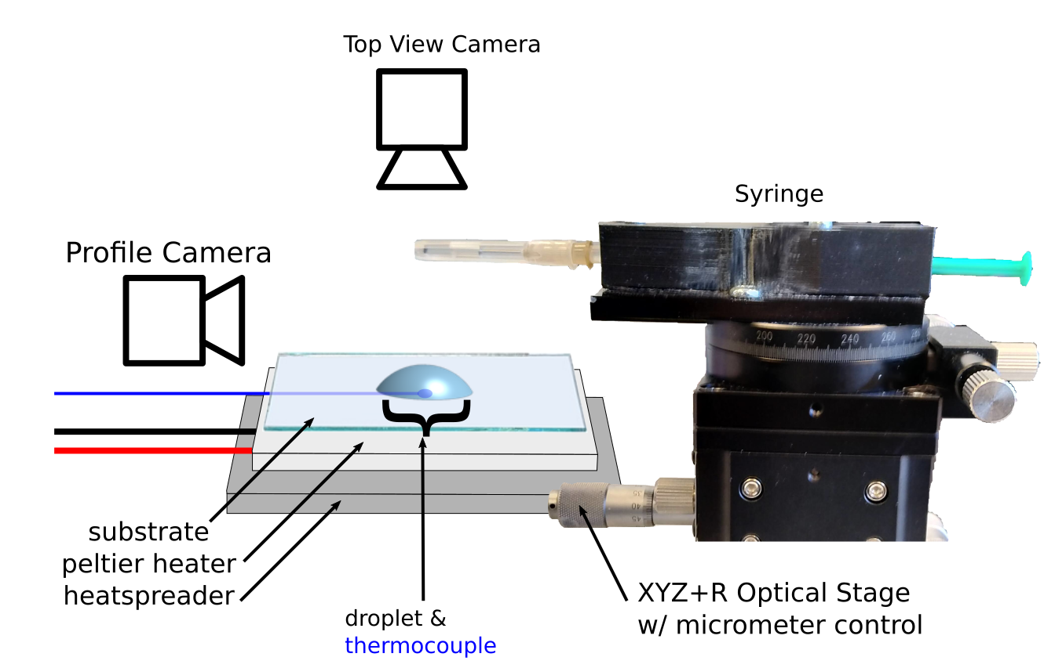
Experimental Overview
Goal: To characterise behaviour of a droplet impacting and evaporating from a given substrate.
Applications:
Spray Cooling
Inkjet Printing
Spray Drying Manufacture
Old Approach: Manual Dispensing of liquid drop onto heated substrate with single point measurement.

Slide 3
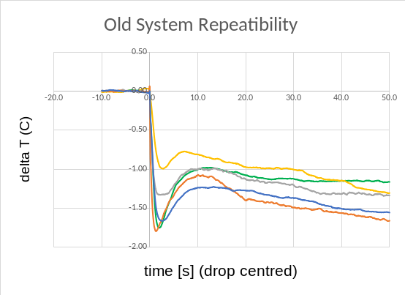
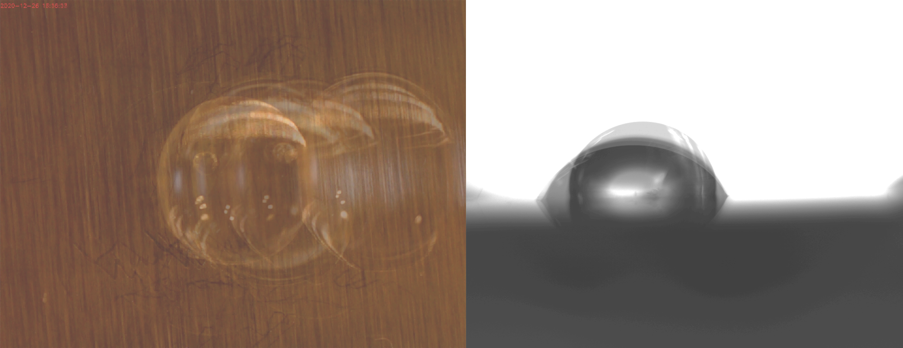
Motivation
Results and performance of the initial setup had issues with consistency and repeatability.
This project aims:
Evaluate origins of inconsistencies
Design, construct & test new high precision instrumentation
Provide environmental monitoring system
Temperature Curves
Corresponding Droplets

Slide 4
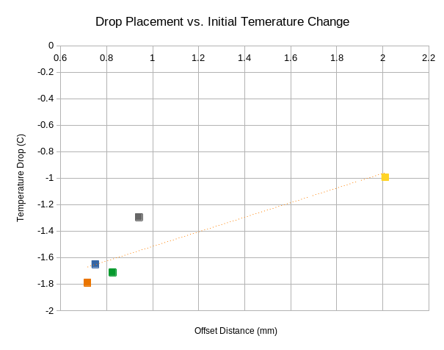
Initial System Analysis
Drop Placement vs. Temperature Drop
 | Position (mm) | Volume (uL) | Delta T (ºC)
Variance | 0.296 | 0.629 | 0.112
Hypothesis: Procedural factors have a higher likelihood of varying (with old system) and greater contribute to the variation and repeatability of the results
Approach: Implement a system to control for position and volume, assess its performance and investigate its effect on the experimental data
Temperature Drop (ºC)
Offset distance (mm)
Procedural | Environmental
Position | Humidity
Volume | Temperature
Contact angle* | Pressure
Notes:
Positional variation also limits the resolution of the overhead camera as you need to zoom out further to capture all variation

Slide 5
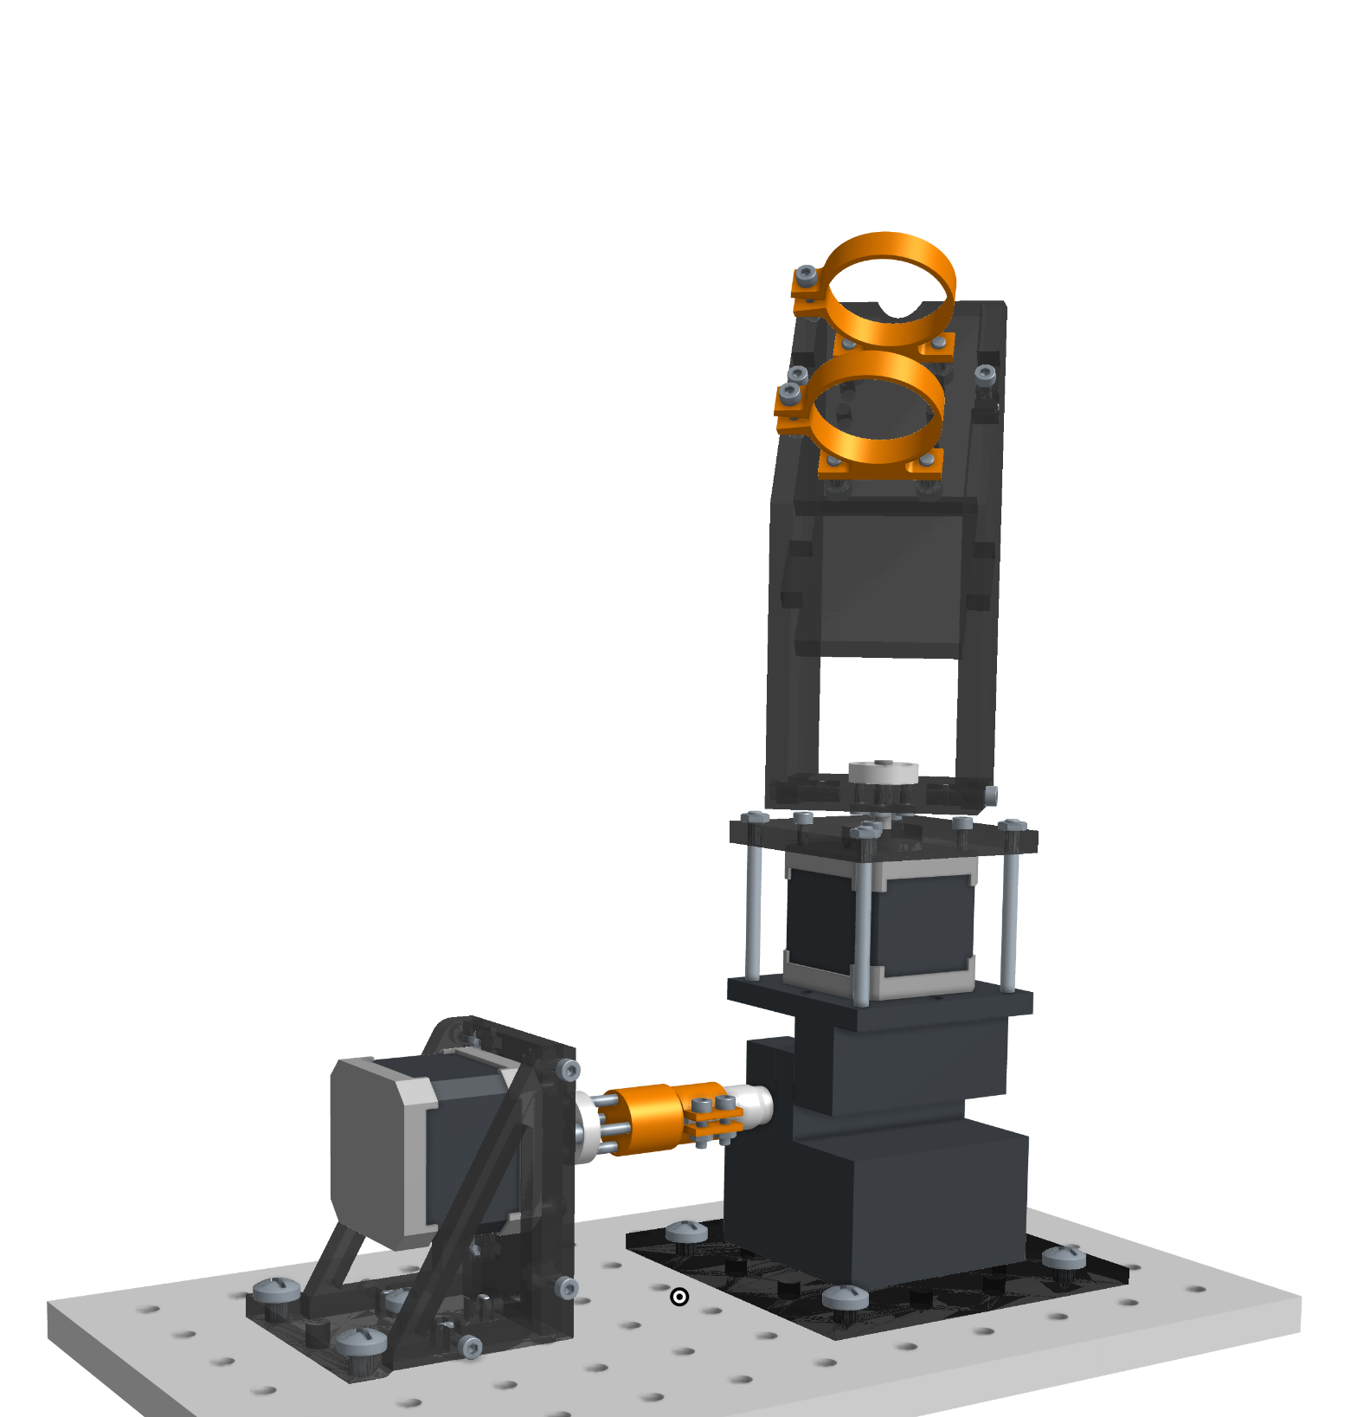
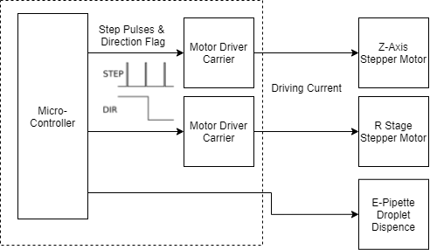
Design Approach
Motorised Stage Architecture
Full driving Assembly

Slide 6
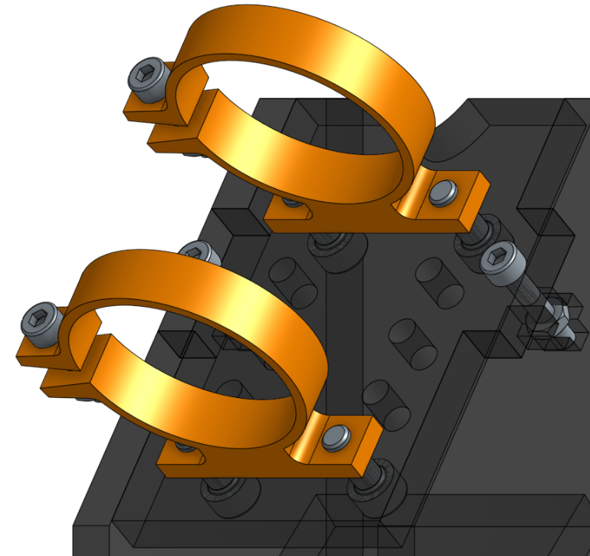
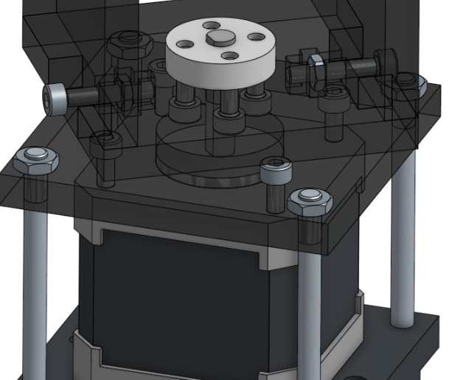
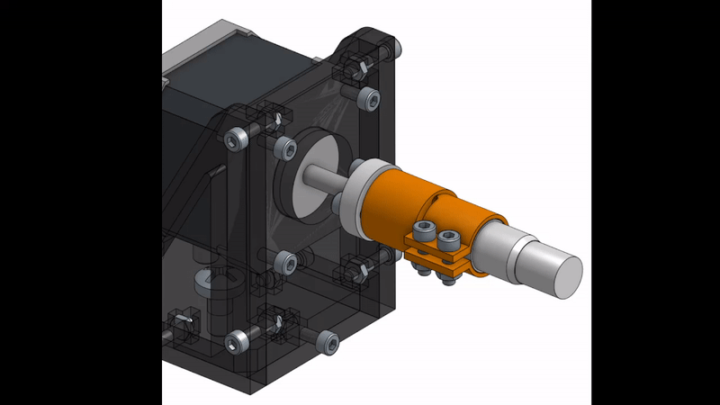
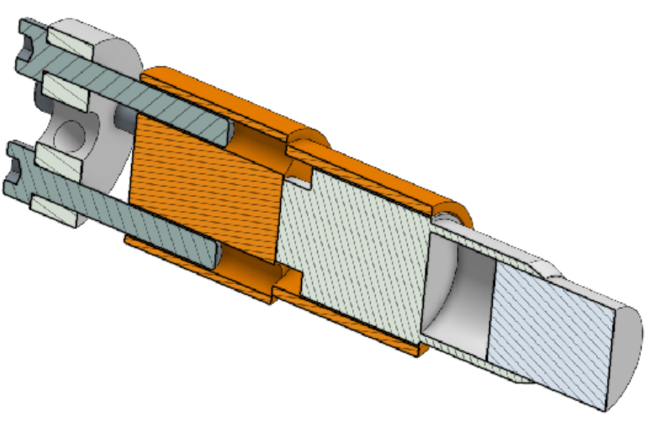
Design Requirements
Serial Interface Instrumentation Controller
Exact positions & timing input
Automated procedures
Droplet Dispensing
Electronic Pipette
Calibrated variable volume
Intercept control for remote dispensing
Mechanical Requirements
Z: Sliding coupler from motor to stage
R: Minimising Oscillation in pipette tip
Pipette: Mounting to meet angle and position
Rotating Pipette Stage
Z motor & micrometer sliding coupler

Slide 7
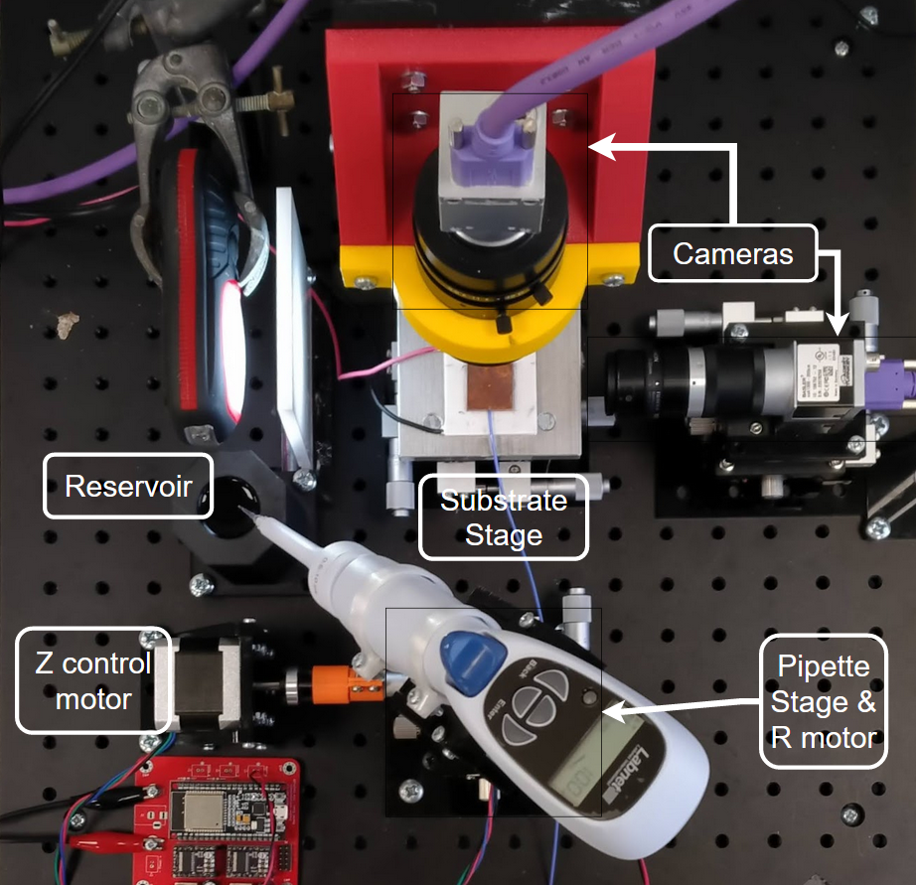
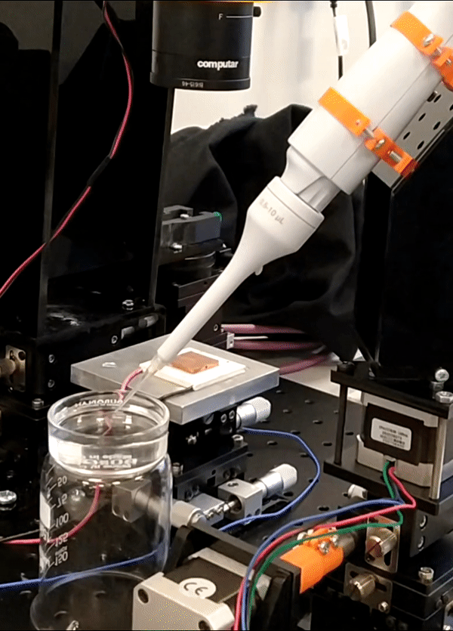
Fully Constructed System

Slide 8
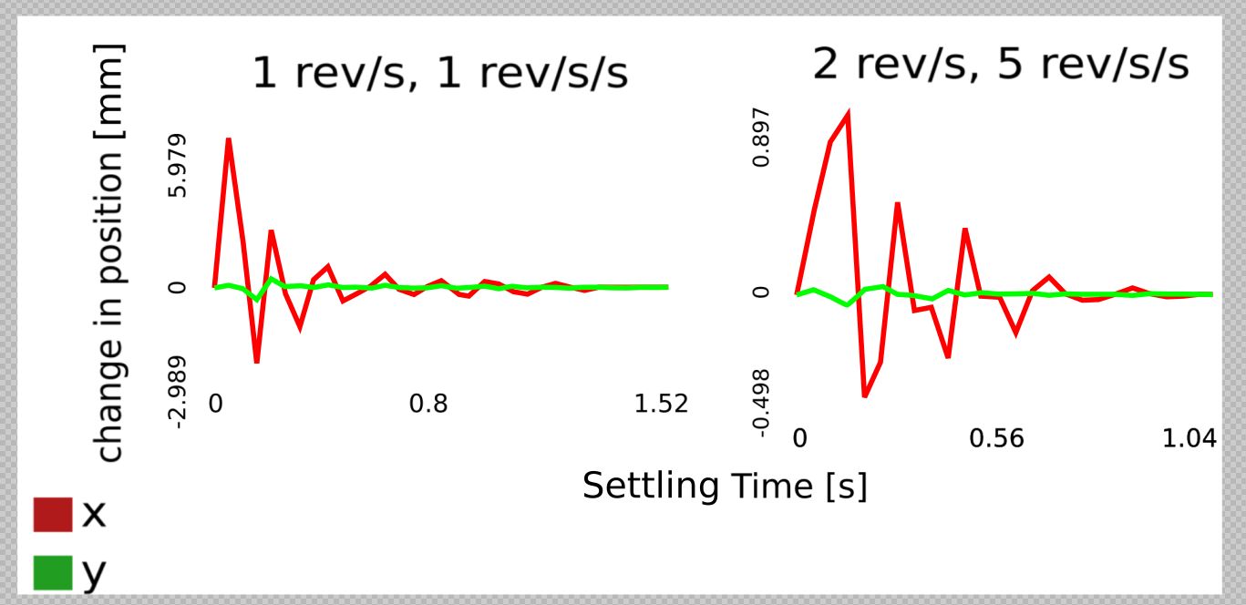
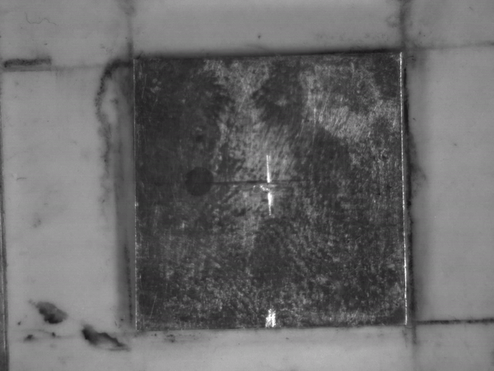
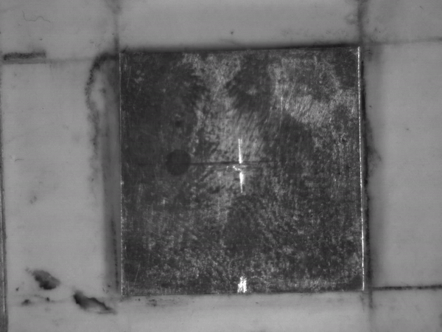
Results - Mechanical
Tuning motor speed and ramping acceleration
Minimised tip oscillations to <1 mm of overshoot in 1s.

Slide 9
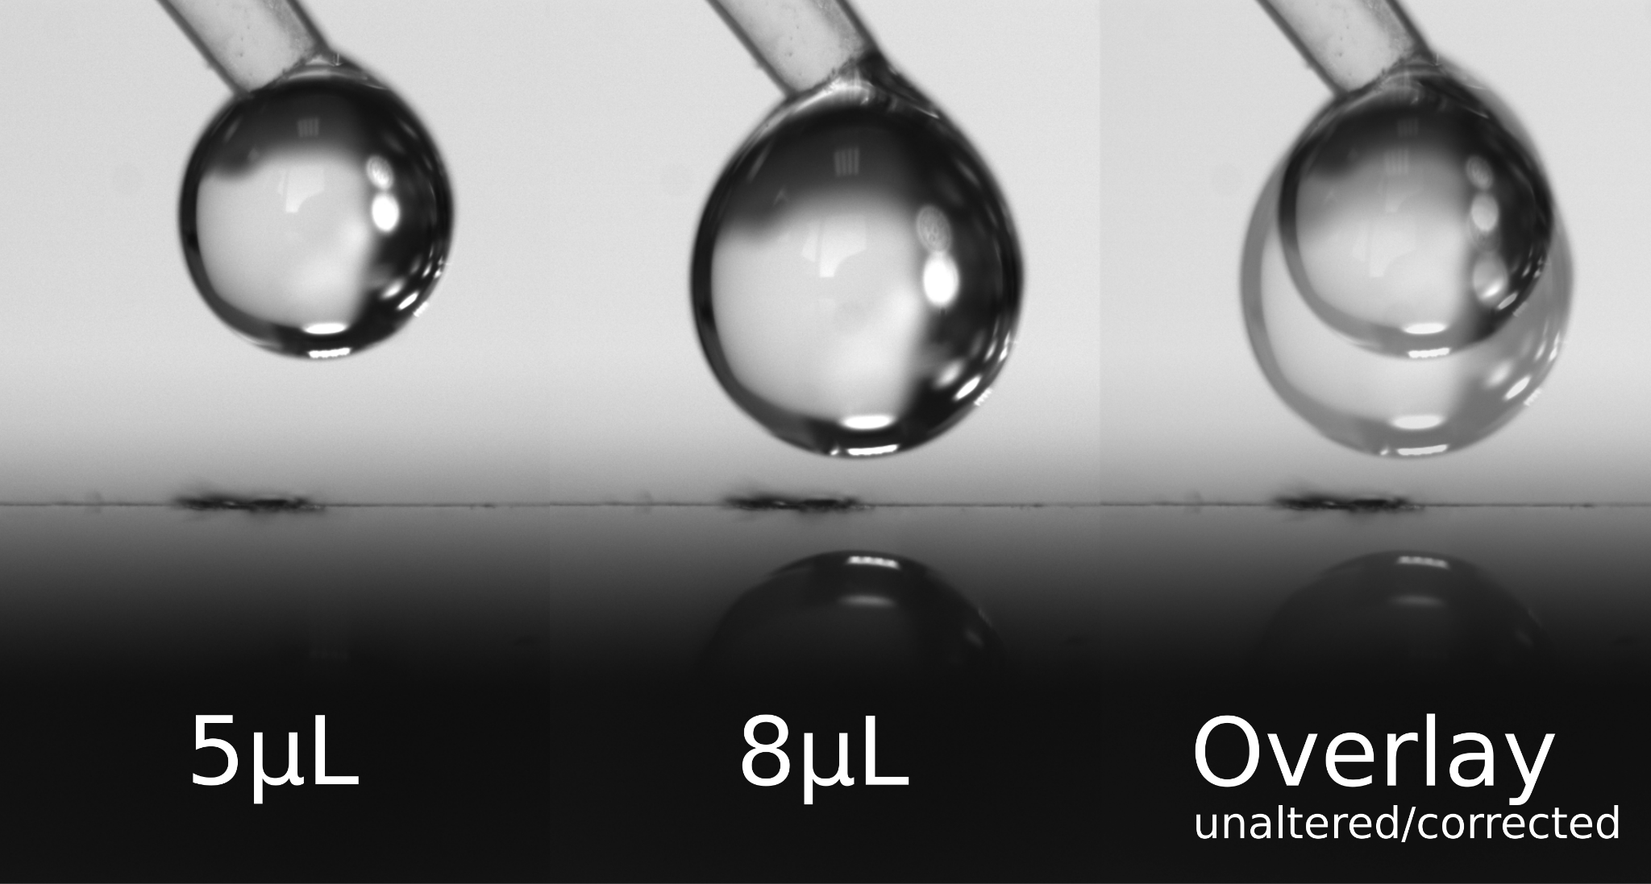
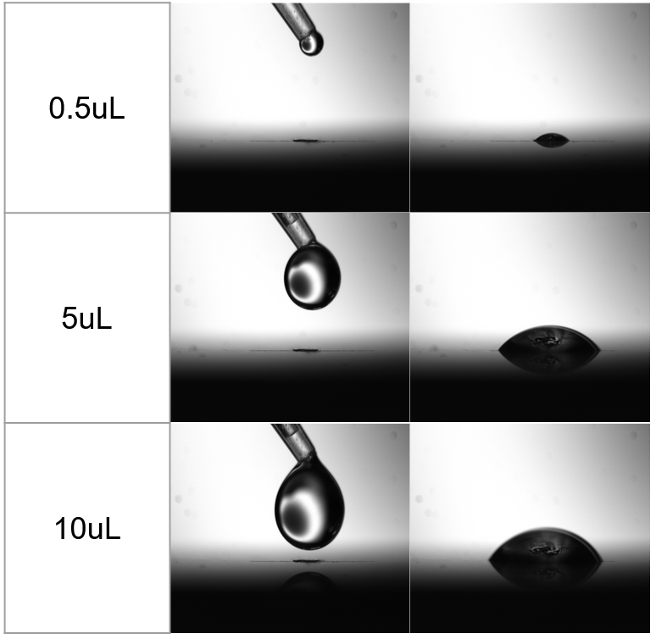
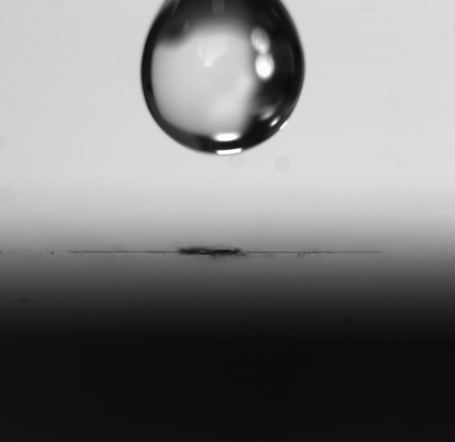
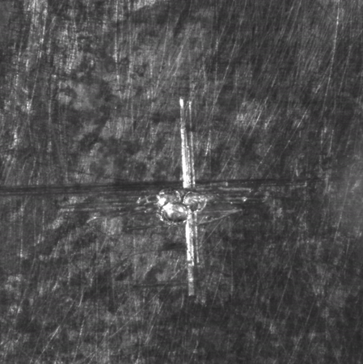
Results - Droplet Dispensing
Repeatable tip positioning
Motorisation consistent and tip positioning precise run to run
Resulting in accurate droplet deposition
Variable volume
Mechanical stability is enough to allow pipette full volume range of 0.5uL to 10uL
Z travel must be adjusted

Slide 10
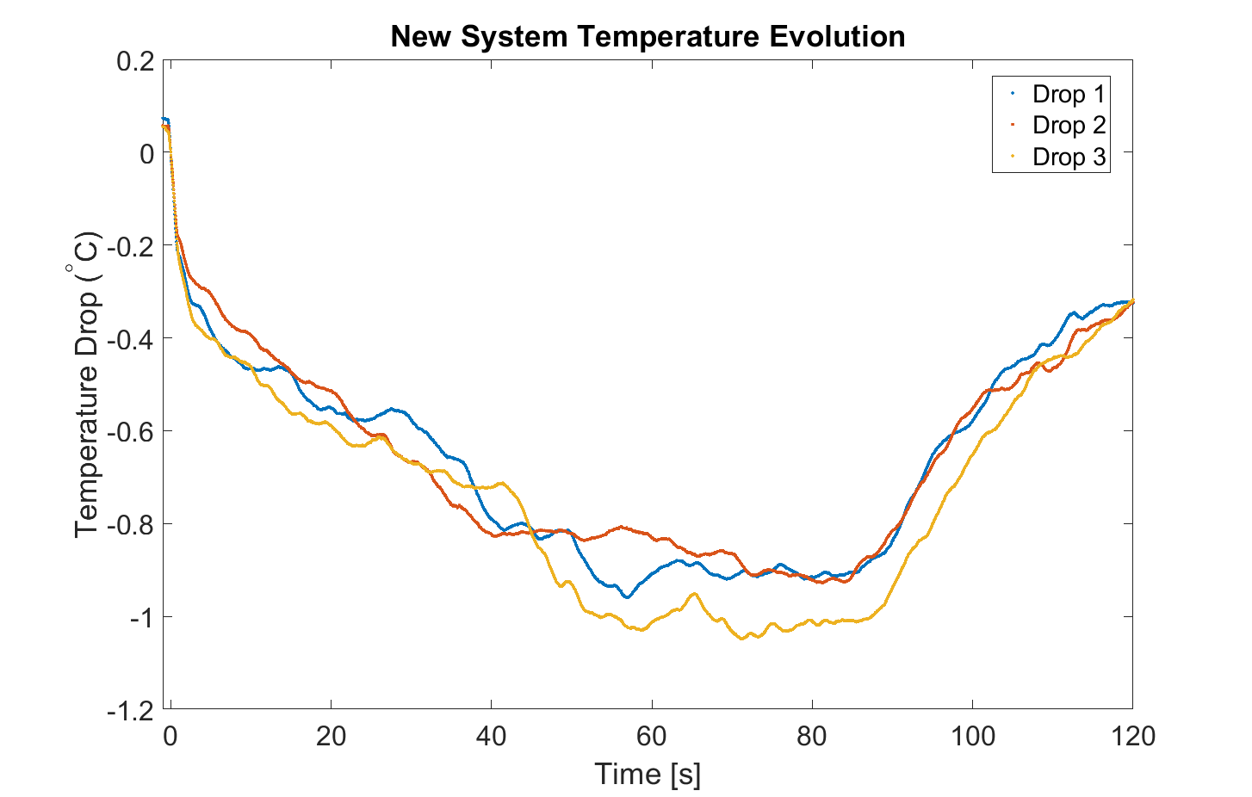
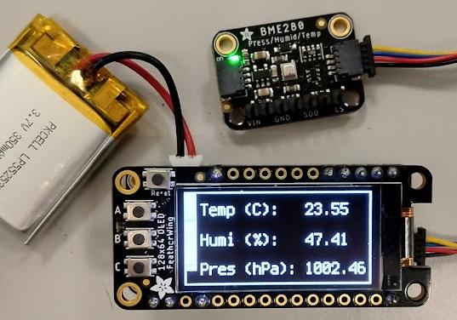
Conclusions
The produced instrumentation successfully:
Improves droplet positional variance from 0.296mm to 0.0175mm
Shows a promising improvement to the consistency in temperature data
Environmental monitor
 | Position (mm) | Delta T (ºC)
Old variance | 0.296 | 0.112
New variance | 0.018 | 0.003
Notes:
Say 10x

